Slide 1
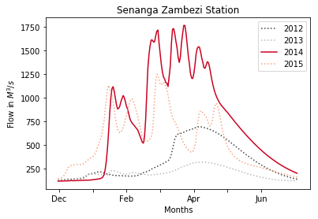
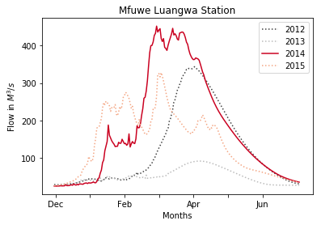
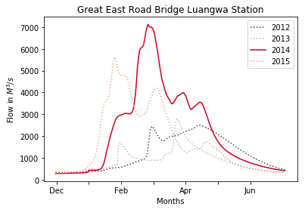
Flood affected districts in 2014
Province | District | Affected Population(Persons) | Number of internaly displaced persons | Glofas station | Peak flow (m3/s)
Eastern | Chadiza | 33,422 |  | -
Eastern | Lundazi | 95,470 |  | -
Eastern | Nyimba | 29,396 |  | GreatEastRoadBridge_Luangwa | 7000
Luapula | Milenge | 18,818 | 1176 | Mbati_Chambeshi | 1200
Muchinga | Chinsali | 22,062 |  | Mfuwe_Luangwa | 450
Muchinga | Shiwangandu | 14,708 |  | Mfuwe_Luangwa | 450
Western | Kalabo | 27,884 |  | Senanga_Zambezi | 5100
Western | Limulunga | 10,690 |  | Senanga_Zambezi | 5100
Western | Mongu | 16,035 |  | Senanga_Zambezi | 5100
Western | Shangombo | 19,757 |  | Senanga_Zambezi | 5100
Western | Sikongo | 18,589 |  | Senanga_Zambezi | 5100
Western | Sioma | 8,467 |  | Senanga_Zambezi | 5100
Western | Nalolo | 14,388 |  | Senanga_Zambezi | 5100
Western | Senanga | 21,581 |  | Senanga_Zambezi | 5100
Luapula | Lunga | - | 120 | Mbati_Chambeshi | 1200
Luapula | Samfya | - | 504 | Mbati_Chambeshi | 1200
Eastern | Mambwe | - | 480 | Mfuwe_Luangwa | 450
North-Western | Kabompo | - | 2112 | KabompoBoma_Kabompo | 1000
North-Western | Kasempa | - | 2376 | Lubungu_Kafue | 1200

Slide 2
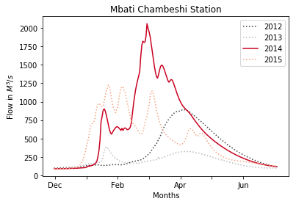
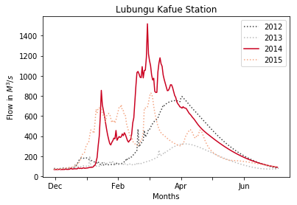
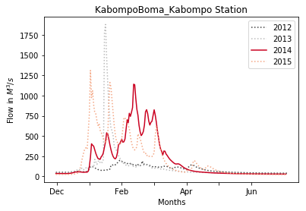
Flood affected districts in 2014
Province | District | Affected Population(Persons) | Number of internaly displaced persons | Glofas station | Peak flow (m3/s)
Eastern | Chadiza | 33,422 |  | -
Eastern | Lundazi | 95,470 |  | -
Eastern | Nyimba | 29,396 |  | GreatEastRoadBridge_Luangwa | 7000
Luapula | Milenge | 18,818 | 1176 | Mbati_Chambeshi | 1200
Muchinga | Chinsali | 22,062 |  | Mfuwe_Luangwa | 450
Muchinga | Shiwangandu | 14,708 |  | Mfuwe_Luangwa | 450
Western | Kalabo | 27,884 |  | Senanga_Zambezi | 5100
Western | Limulunga | 10,690 |  | Senanga_Zambezi | 5100
Western | Mongu | 16,035 |  | Senanga_Zambezi | 5100
Western | Shangombo | 19,757 |  | Senanga_Zambezi | 5100
Western | Sikongo | 18,589 |  | Senanga_Zambezi | 5100
Western | Sioma | 8,467 |  | Senanga_Zambezi | 5100
Western | Nalolo | 14,388 |  | Senanga_Zambezi | 5100
Western | Senanga | 21,581 |  | Senanga_Zambezi | 5100
Luapula | Lunga | - | 120 | Mbati_Chambeshi | 1200
Luapula | Samfya | - | 504 | Mbati_Chambeshi | 1200
Eastern | Mambwe | - | 480 | Mfuwe_Luangwa | 450
North-Western | Kabompo | - | 2112 | KabompoBoma_Kabompo | 1000
North-Western | Kasempa | - | 2376 | Lubungu_Kafue | 1200

Slide 3
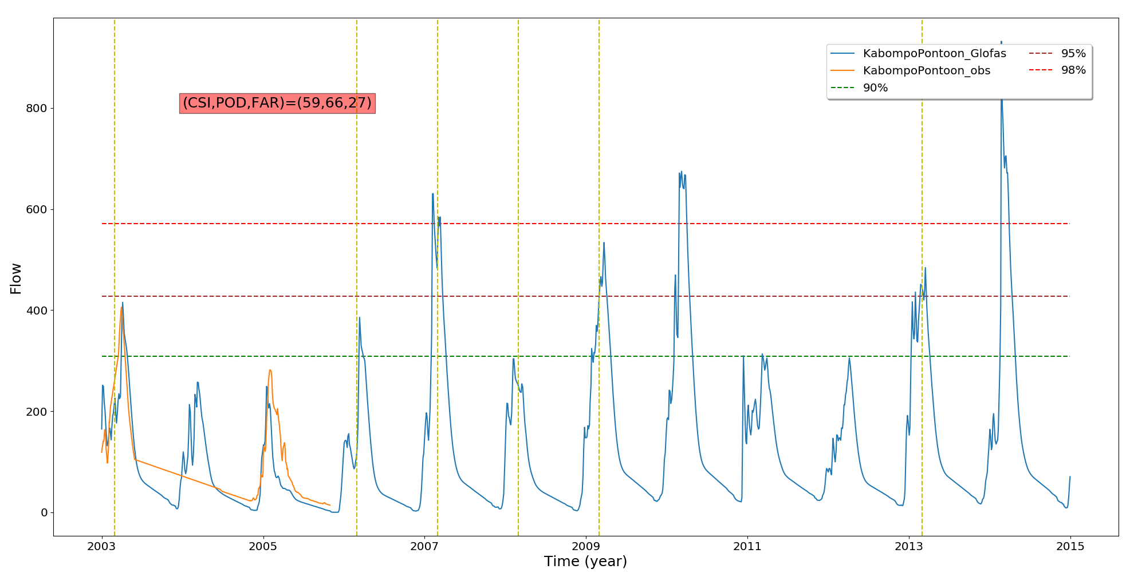
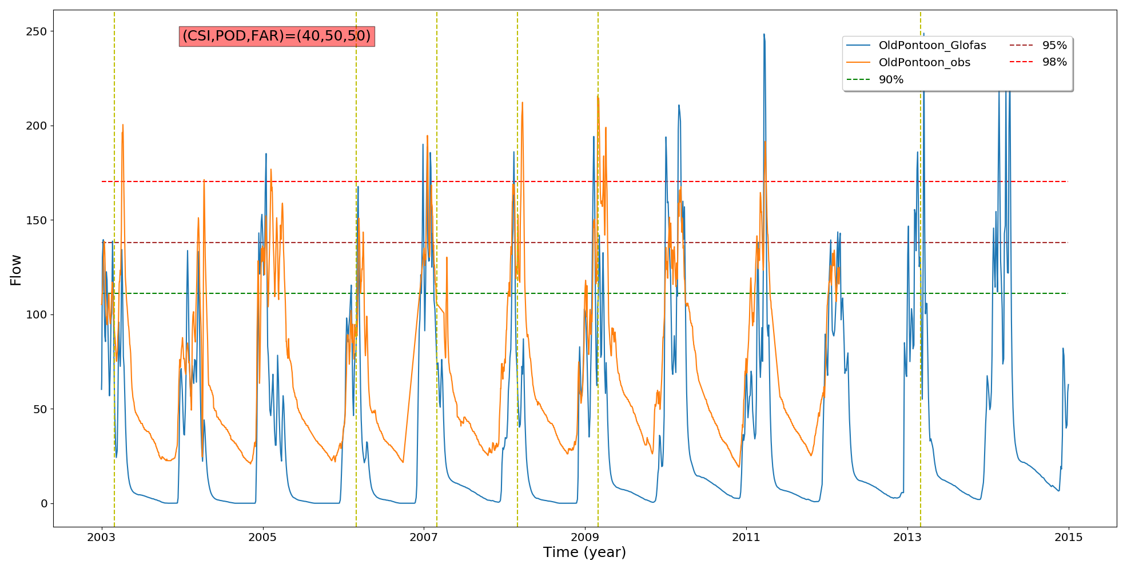
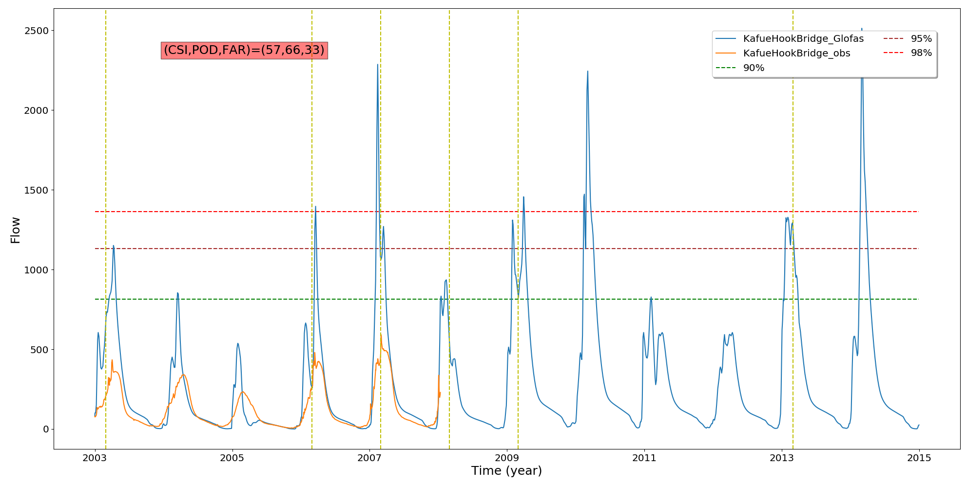
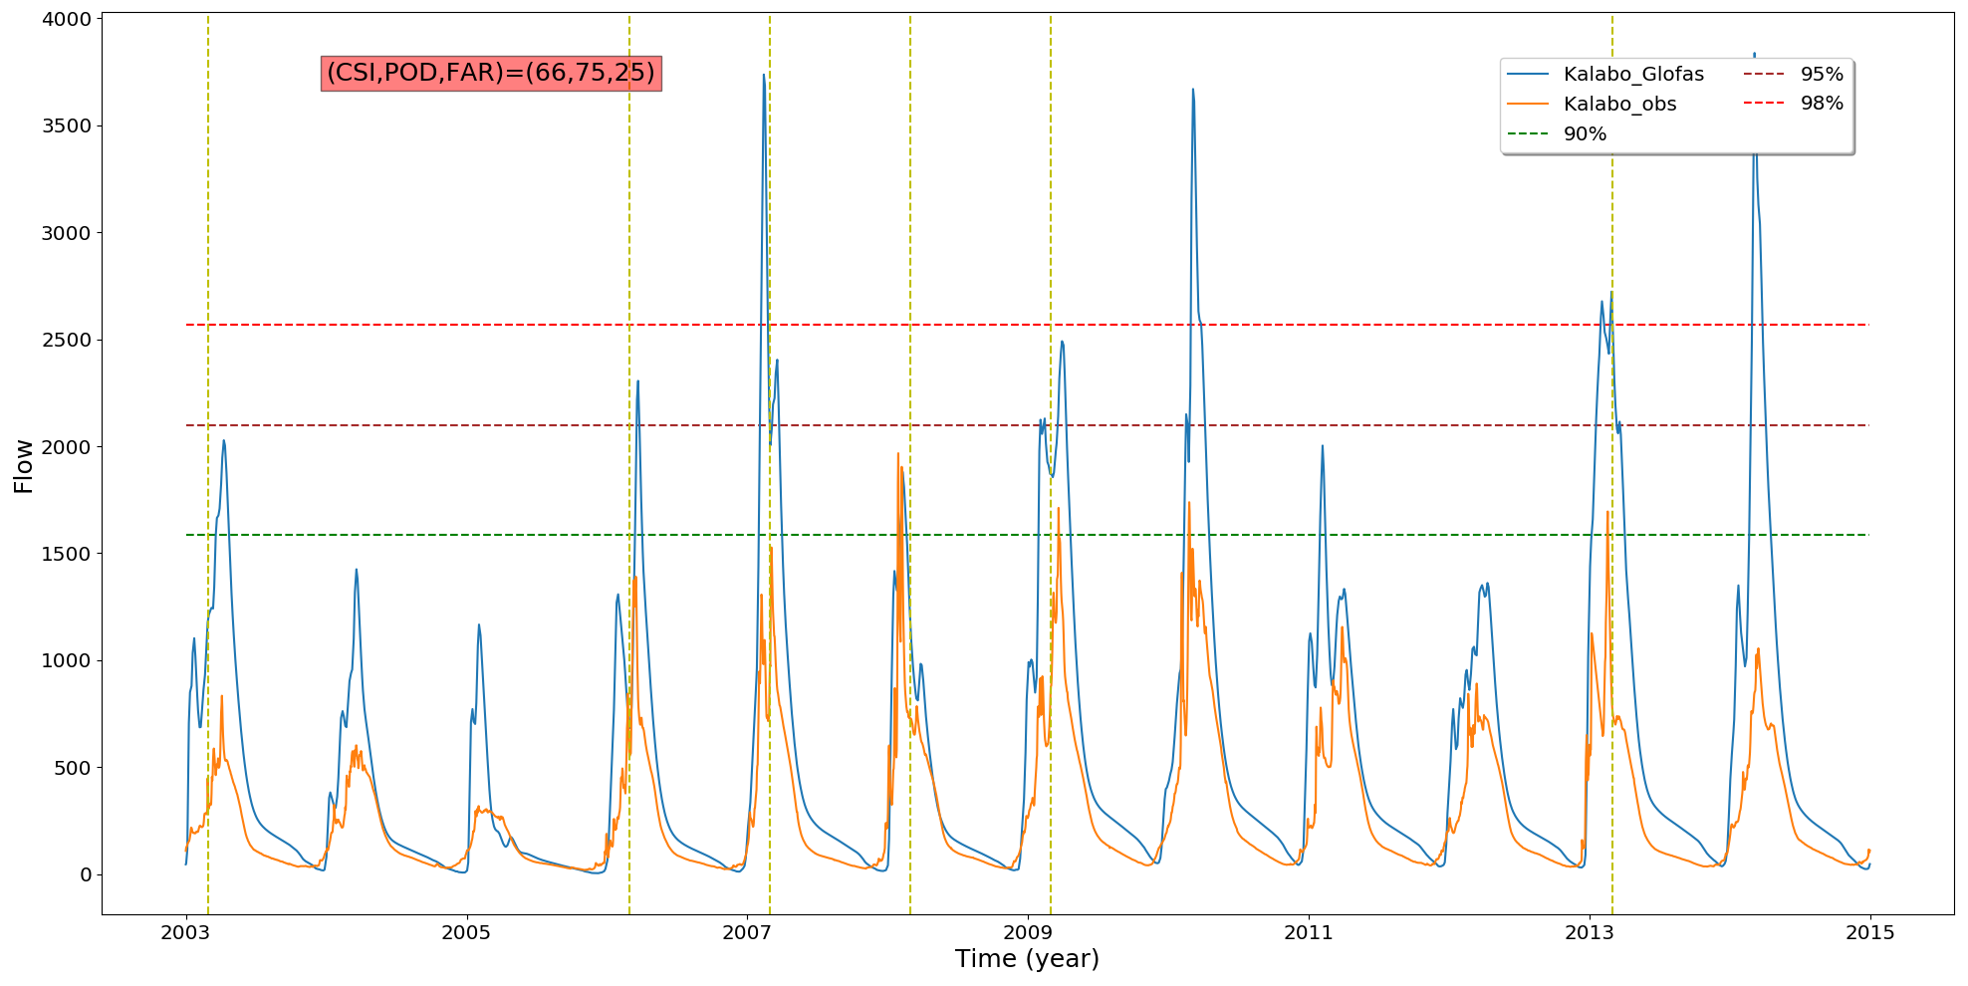
OBSERVATION VS GLOFAS

Slide 4
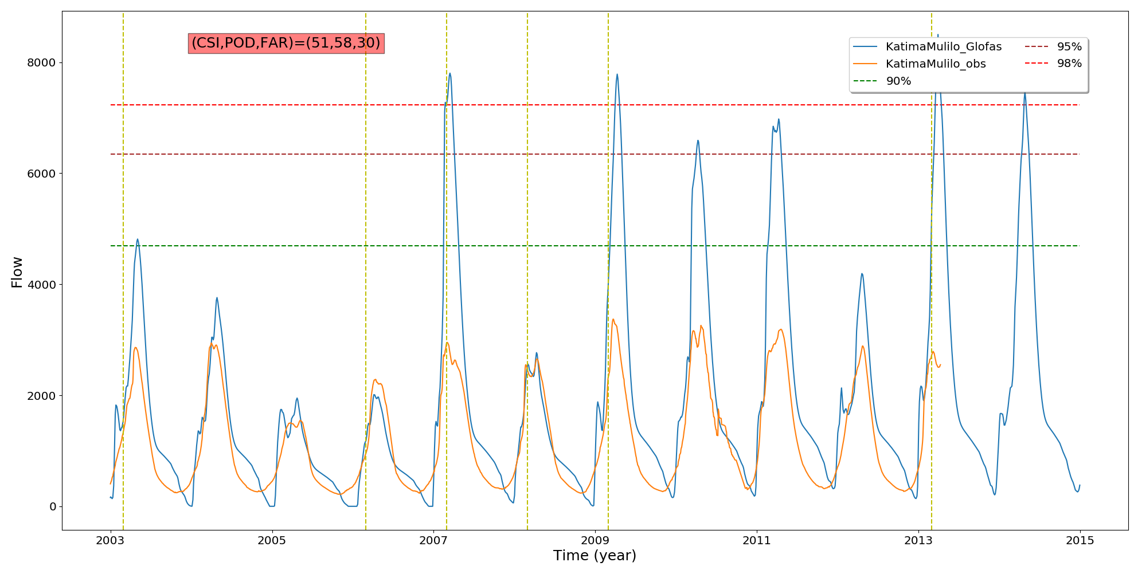
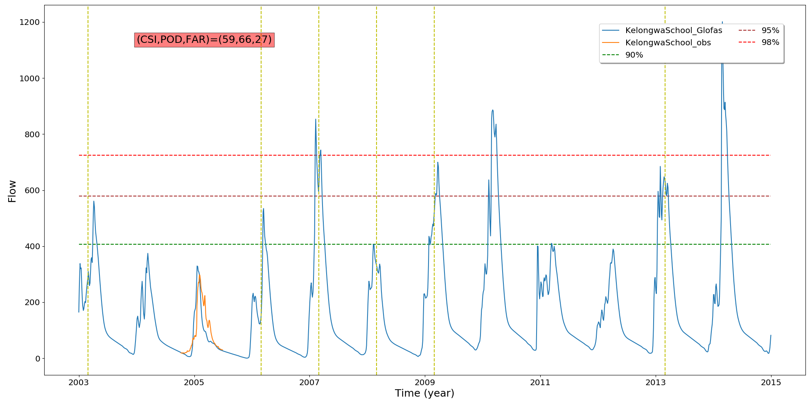
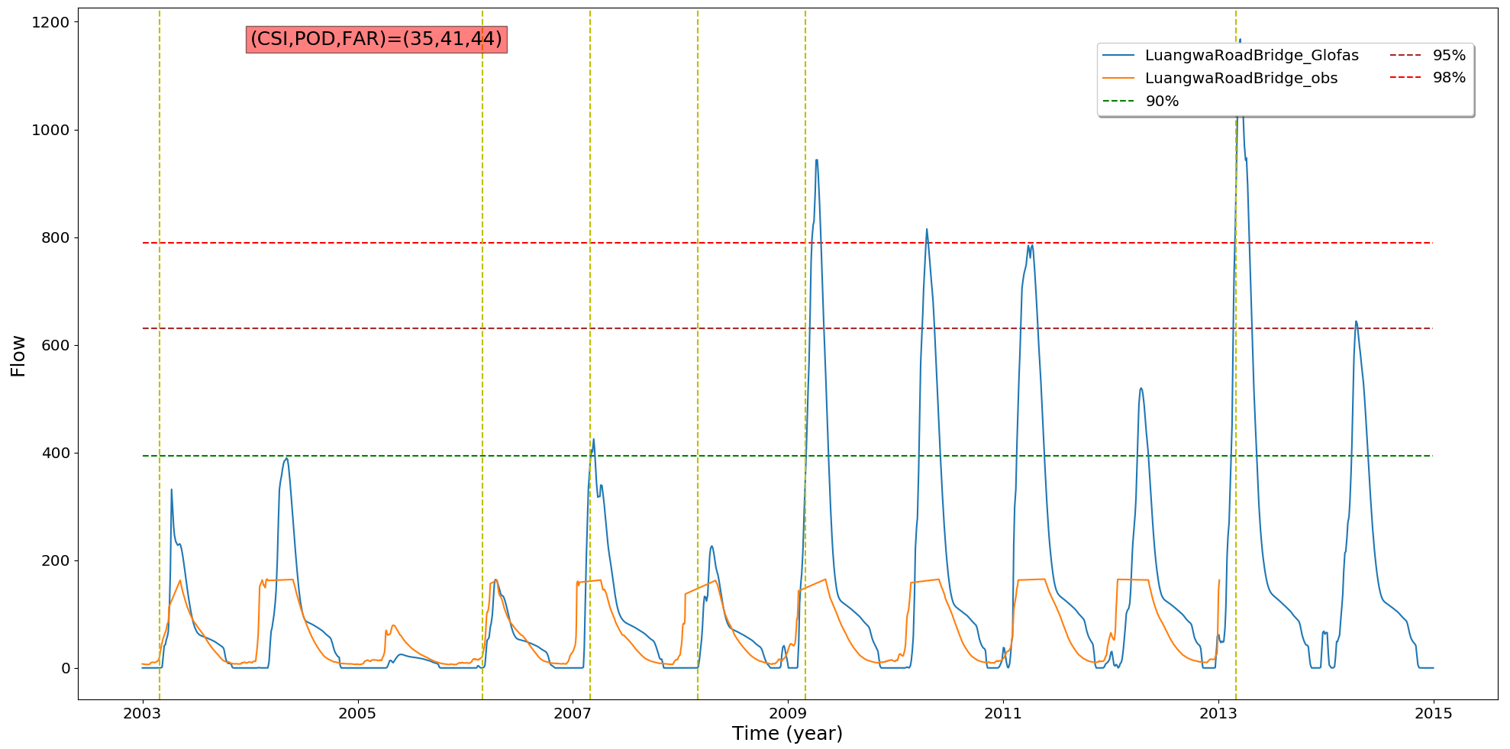
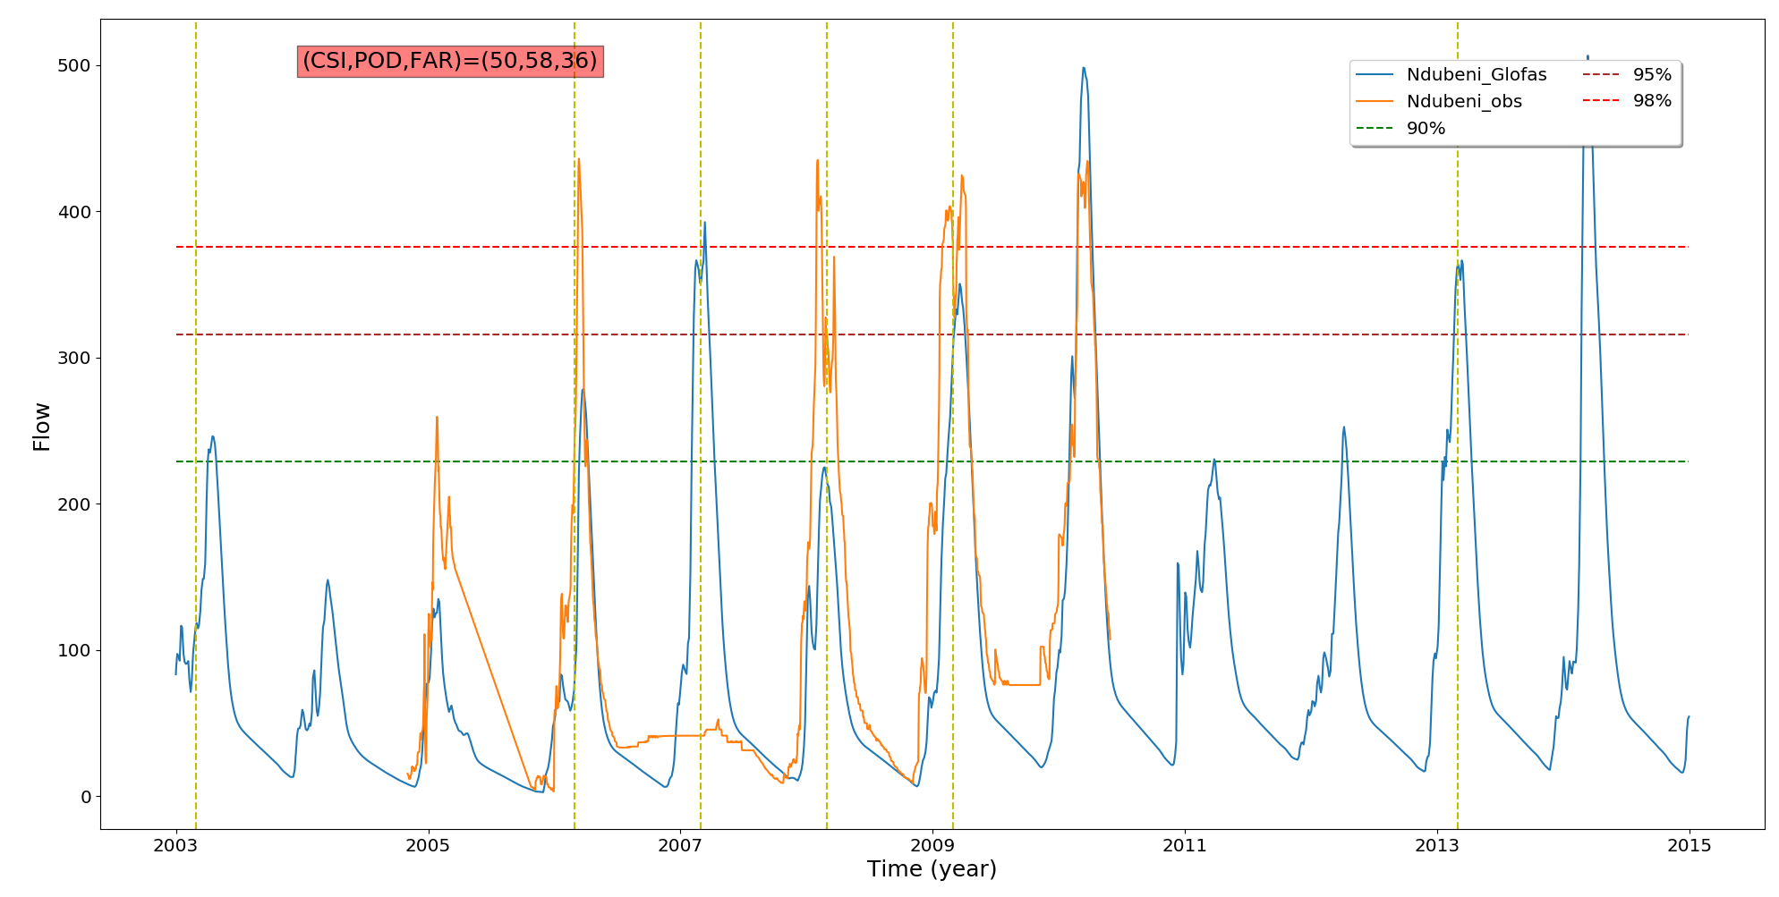
OBSERVATION VS GLOFAS

Slide 5
